Slide 1
business Assessment scores using yelp reviews
Ankur Patel
Drazen Zack

Slide 2
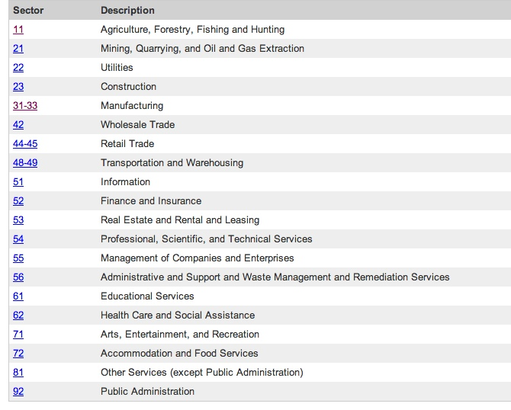
What are NAICS Codes
North American Industry Classification System
Code system developed for use by the Federal Statistical Agencies
For collection, analysis and publication of statistical data for the US Economy
Establishments are classified to an industry according to the primary business activity
Organization:
Sector: 2-digit code
Subsector: 3-digit code
Industry Group: 4-digit code
NAICS Industry: 5-digit code
National Industry: 6-digit code
Notes:
So what are NAICS Codes? It’s a system developed jointly by US, Canada, and Mexico for the business statistics in North America.
The system is for comparability in business statistics among those countries.
The codes in the system are classified as sectors, subsectors, more detailed classifications. We worked for the scores for Sectors/industries.
20 sectors/industries (some sectors have range of codes because they have wider variety of company types)

Slide 3
Goal & Importance
Goal:
Develop an assessment score (0-100) for NAICS Codes from reviews and ratings from social networking sites.
Importance:
Compare social networking sites by industry
Different social networking sites favor different industries
Compare industries within a social networking site
How do we create a score that could be used for all industries and multiple social networking sites?
Notes:
Score from review and ratings from social sites
Compare what reviews from different platforms say about an industry
Compare the industries within a platform

Slide 4
Data Sources Exploration

Slide 5

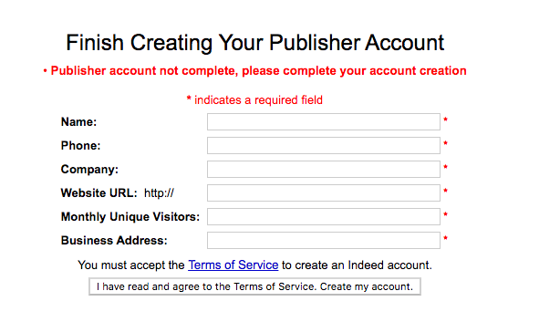
Data Sources Exploration: Indeed
Plenty of reviews for every industry
Easy to scrape
Indeed API
Must apply to become a publisher
Be part of a business or organization
Indeed has the right to place limits on access to any API
Reviews are only for the organization as a whole

Slide 6

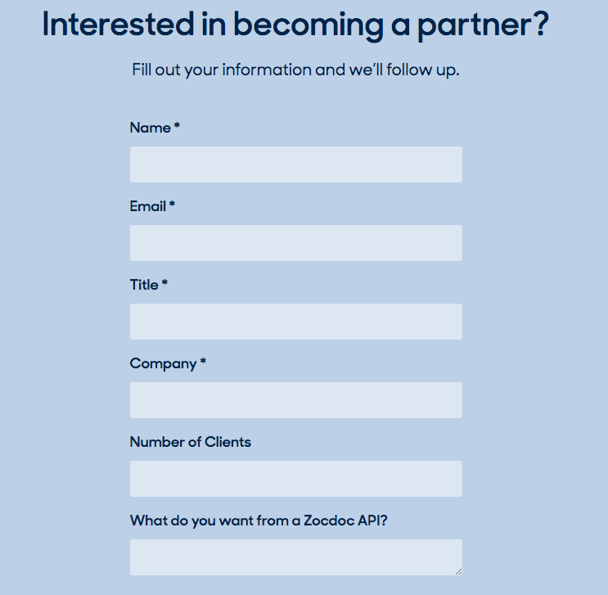
Data Sources Exploration: Zocdoc
Great for health care industry
Zocdoc API
Have to become a partner with ZOCDOC
Have to be approved
Be a medical company or have a medical practice
Free of cost & No limits

Slide 7

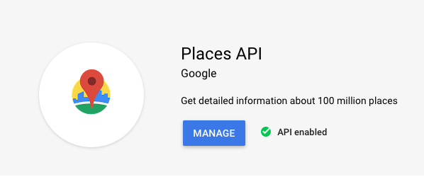
Data Sources Exploration: Google
Plenty of reviews for each industry
Google Place API
Atmosphere Data (rating, reviews)
Pay as you go plan
Only 5 reviews per business

Slide 8

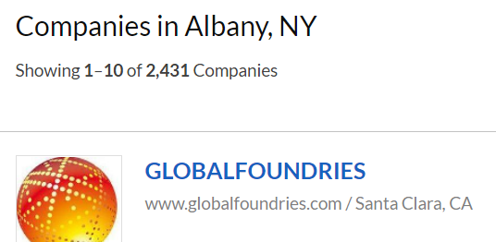
Data Sources Exploration: Glassdoor
“Search ratings and reviews of over 600,000 companies worldwide.”
Doesn’t have API for reviews
Explored data size before requesting permission
Scrapy – Spiders
Problems:
Inconsistent Results
Search redirected to other city's page
Showed other cities, states, countries
Notes:
Glassdoor doesn't have an API for reviews; has Company Search API
PyCharm for python script (to extract text content from html based on css selectors)
When searching for specific city, it redirected to another (e.g. NYC) city

Slide 9
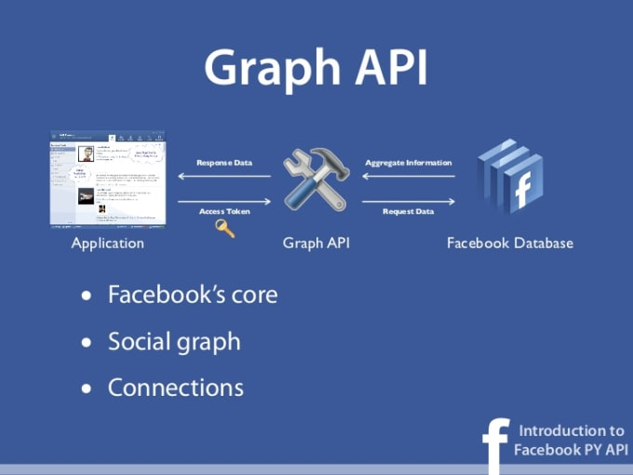


Data Sources Exploration: Facebook
Facebook:
Graph API Explorer or Access Token
Ratings and Reviews for a business Facebook Page
Need User ID for a Business
Notes:
Tried Graph API on developer platform
Not useful for our project, no company reviews
Facebook pages had city, teams, clubs
Other cities, places… same URL

Slide 10

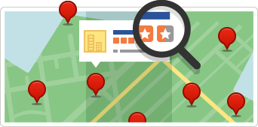
Data Sources Exploration: Yelp
Limited industries
Accommodation and Food Services
Retail Trade
Finance and Insurance
Other Services
Yelp does not allow scraping
Limits of 1000 pages and 30000 companies per category
Yelp Knowledge API for Yelp Reviews
Yelp Open Dataset
An all-purpose dataset for learning
Notes:
Yelp has limited industries, which was found by using scrapy to count number of companies for industries.
Yelp also requires permission, can’t scrape. It also has limitations
Yelp Knowledge API for Partners. Apply for Partners

Slide 11
TEXT MINING: YELP REVIEWS

Slide 12
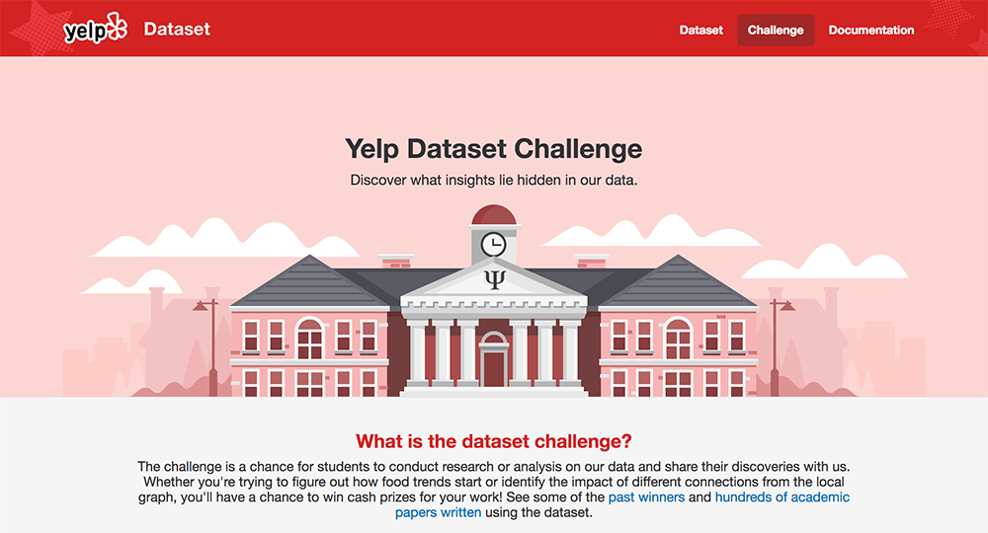
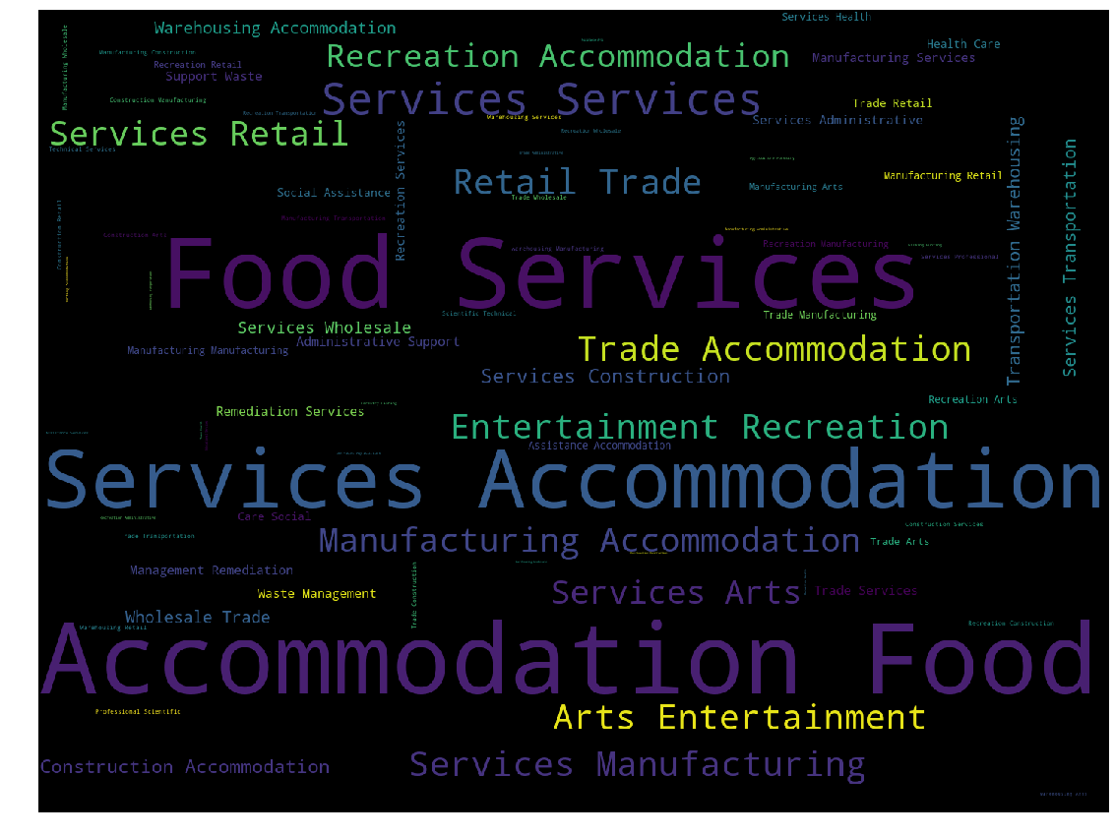
Text Mining: Yelp Dataset
Due to limitations from data sources, the goal for this project is to create assessment scores for the NAICS Codes using reviews in the Yelp dataset.
Only the NAICS Code 72 of Accommodation and Food Services is used initially to create methods, after which the best method will be used for all the NAICS Codes.
Two files used
Business file
Review file
Notes:
Due to those limitations, we used Yelp Open Challenge dataset.
We explored the dataset before mining to get a brief understanding of the data.
We selected businesses that fit the NAICS Codes. A quick glimpse at this wordcloud shows that it’s majorly Accommodation and Food Services sector.

Slide 13
Preprocessing Dataset
Used categories column from business file to match to NAICS subsectors
Merged businesses that fit a NAICS code in the business file to review file
6,685,900 reviews to 1,266,827 reviews
Took a sample of Accommodation and Food Services
1 million plus reviews to 467,688
Other task done
Checked to see if all reviews were in English
467,688 reviews to 454,427 reviews
1,266,827 reviews to 1,119,273 reviews for larger dataset
Added a column for positive and negative reviews by star rating
Clean Text

Slide 14
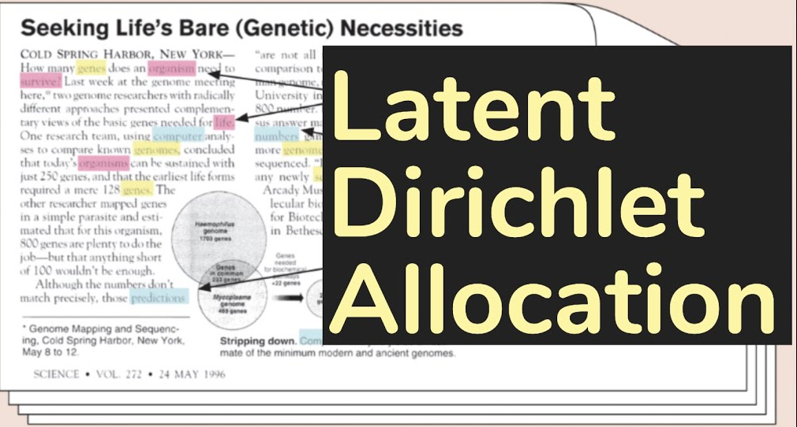
Sentiment Analysis Methods
Latent Dirichlet Allocation (LDA)
Topic modeling
LdaMulticore: Parallelized, multicore CPUs
Domain specific lexicon
Create a lexicon base on social network domain
Methodology for Twitter Sentiment Analysis
Notes:
Tried different sentiment (polarity, subjectivity) analysis methods from Premade lexicons, didn’t give usable results.
LdaMulticore was used for topic modelling. It’s basically LDA with multiple CPU processing
Topic Modelling: phrases (common words) bigrams, num_topics, filter_extremes to not select insignificant or biased topics, chunksize, passes like epochs, workers like processors (default CPUs -1, cpu_count – 1 for optimal performance)
Created domain specific lexicon
num_topics- specify how many topics you would like to extract from the documents
Alpha- document-topic density, the greater, the article will be assigned to more topics, vice versa
Eta- topic-word density, the greater, each topic will contain more words, vice versa

Slide 15
Latent Dirichlet Allocation

Slide 16
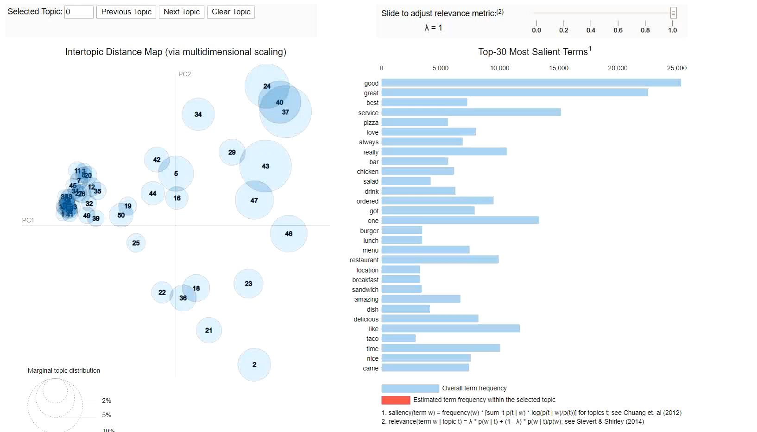
pyLDAvis
Notes:
A method for visualizing and interpreting topics
LDAvis: combination of R (statistical analysis) and D3 (for javascript dynamic visualization)
A method for visualizing and interpreting topics; deep inspection of the terms most highly associated with each individual topic
Area of circle represents the importance of topic over corpus, distance between circle centers represents similar between topics
-selecting individual topics selects only those topics (outstanding only in topic 2)

Slide 17
LdaMultiCore
Logistic Regression
X: Topic Models
Y: Sentiment
Training:
Number of reviews tried: 10000, 40000, 80000, 160000, 240000
Number of topics tried: 50, 200
Target: Stars, TextBlob
Best training model:
Testing results were weak because the new test data topics don’t fit the model
Model | Reviews | Topics | Target | F1 Score | Accuracy | Sensitivity | Specificity
8 | 240,000 | 50 | Stars | 0.916 | 0.870 | 0.870 | 0.874
Notes:
Model parameter solver=newton method (linear conjugate gradient algorithm) for smooth optimization https://arxiv.org/abs/1803.02924
Evaluating by measuring performance of the document classification… Metrics showed similar values, stars/textblob were identical methods (stars=user, textblob=lexicon function)
Model 9 was evenly distributed according to Stars by using sampling, but not improved results
Hierarchical Dirichlet Processing – same with all topics, but that would also result in different topics (http://www.cs.columbia.edu/~blei/papers/BleiJordan2004.pdf)
LDA probabilistic approach… Other matrix factorization techniques – LSI, NMF
After testing the trained models, it shows much lower results because the model was built on the training data and does not include topics from the new test data.
The 80-90% accuracy was from the train and test set that were used for the topic modeling.

Slide 18
domain specific lexicon Methodology

Slide 19
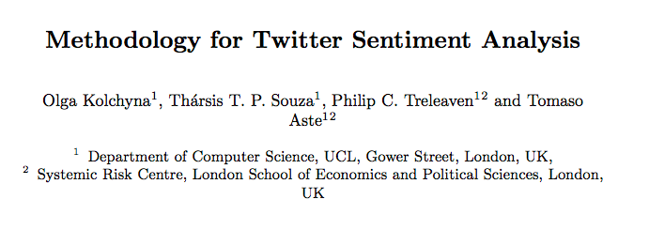
Methodology From
Methodology for Twitter Sentiment Analysis
Machine learning & lexicon methods
Pre–label data
Machine Learning using Naive Bayes & SVM
Created lexicon & sentiment score from trained data
Sentiment Score

Slide 20
Methodology
Count vectorize
Count # of times feature is in a Negative or Positive reviews
Calculate Positive Score
Remove Positive Scores between (0.4-0.6)
Calculate Polarity Score
Lexicon created
Positive and Negative review column
Clean text Dataset

Slide 21
Domain Lexicon
Lexicon Created
Used two datasets
454427 reviews only Accommodation and Food Services
1.1 million reviews All NAICS codes
Number of features (single words, 2-grams, 3-grams)
5,000, 7,000, 9,000, 11,000 (11,000 only for smaller dataset)
Using all reviews & under sampling positive reviews
Classification test
Created a lexicon on train dataset
Tested on test dataset (not used to create the the lexicon)
454,427 (Train: 363,541, Test: 90,886)
1.1 million (Train: 895,418, Test: 223,855)

Slide 22
Test Results
No Sampled All Data
Sampled 40% of the positive reviews
Features | Accuracy | Recall 1 | Recall 0 | Precision 1 | Precision 0 | f1 score 1 | f1 score 0
5000_small | 0.78858 | 0.99999 | 0.00518 | 0.78836 | 0.9901 | 0.88165 | 0.0103
7000_small | 0.78889 | 0.99999 | 0.00663 | 0.7886 | 0.99225 | 0.8818 | 0.01317
9000_small | 0.78909 | 0.99999 | 0.00756 | 0.78876 | 0.9932 | 0.8819 | 0.015
11000_small | 0.7892 | 0.99999 | 0.00808 | 0.78884 | 0.99363 | 0.88195 | 0.01602
5000_large | 0.78378 | 0.99998 | 0.00704 | 0.78346 | 0.99133 | 0.87858 | 0.01397
7000_large | 0.78424 | 0.99998 | 0.00917 | 0.78382 | 0.99113 | 0.8788 | 0.01817
9000_large | 0.78451 | 0.99998 | 0.0104 | 0.78403 | 0.99412 | 0.87894 | 0.02059
Features | Accuracy | Recall 1 | Recall 0 | Precision 1 | Precision 0 | f1 score 1 | f1 score 0
5000_small | 0.91016 | 0.98734 | 0.62416 | 0.90685 | 0.9301 | 0.94538 | 0.74702
7000_small | 0.91174 | 0.98719 | 0.63213 | 0.90863 | 0.93014 | 0.94628 | 0.75271
9000_small | 0.9134 | 0.98715 | 0.64011 | 0.91043 | 0.93074 | 0.94724 | 0.75854
11000_small | 0.91445 | 0.98713 | 0.64513 | 0.91157 | 0.93117 | 0.94785 | 0.7622
5000_large | 0.91169 | 0.97247 | 0.69332 | 0.9193 | 0.87515 | 0.94514 | 0.7737
7000_large | 0.91326 | 0.97281 | 0.69934 | 0.92079 | 0.87742 | 0.94608 | 0.77832
9000_large | 0.91455 | 0.97322 | 0.70379 | 0.9219 | 0.87973 | 0.94686 | 0.78198

Slide 23
The NAICS Code Score
Review polarity is in a range from -1 to 1
Need to be between 0 and 100
Scaled the polarity using:
((polarity – (-1) /(1 – (-1)) )* 100
Creates normalized scale across all NAICS Codes and social networking sites
Once normalized take mean score for all reviews by NAICS Code
454,427 Reviews
1.1 million Reviews
Features | No Sample | Sample
5000 | 77.723 | 63.566
7000 | 77.726 | 63.596
9000 | 77.769 | 63.649
11000 | 77.802 | 63.703
NAICS Code | 5000 | 7000 | 9000
AFS no sample | 77.09 | 77.12 | 77.16
AEF no sample | 74.48 | 74.51 | 74.57
AFS sample | 62.92 | 63.01 | 63.04
AEF sample | 58.02 | 58.07 | 58.11
AFS = Accommodation & Food Services AEF = Arts, Entertainment & Recreation

Slide 24
Risk & Improvement
Risk domain specific lexicon:
When under sampling strength of positive words decreases
How much to under sample?
Is the polarity of the word accurate
Fake reviews or paid reviews
Improvement domain specific lexicon:
Add supervised learning algorithms into the process or just use lexicon methods
Risk Latent Dirichlet Allocation :
Number of topics (hundreds or 5-10)

Slide 25
